Slide 1

MGT650
Managing People in Organisations
October 2026
Motivating People at Work
Dr Martyn Griffin
m.a.griffin@Sheffield.ac.uk
Sheffield University Management School

Slide 2
Learning Objectives
Gain insight into various theories that explain workplace motivation.
Assess the strengths and limitations of these motivation theories, examining both academic research and practical implications.
Learn how to effectively apply motivational theories and concepts in real-world workplace settings.
Stay informed about emerging trends and future directions in the study of workplace motivation.
Explore the link between motivation, rewards and job design.

Slide 3
Understanding Motivation
Motivation is the driving force behind why employees choose to engage in tasks, how much effort they put into their work, and how long they sustain that effort.
According to Locke and Latham (2004), motivation stems from:
Internal factors that impel individuals to act.
External factors that provide incentives to take action.
Motivation can be broken down into three key elements:
Direction: What an employee chooses to focus on (the goal or task).
Effort: The intensity of energy they invest in their work.
Persistence: The length of time they maintain this effort toward their goal.

Slide 4
Intrinsic & Extrinsic Motivation
Intrinsic Motivation (Internal)
Motivated by internal satisfaction. Completing tasks because they are interesting, fulfilling, or enjoyable.
Example: Employees work hard on a project because it aligns with their interests or values.
Extrinsic Motivation (External)
Motivated by external sources. Complete tasks to earn rewards, gain recognition, or avoid negative consequences.
Example: Employees focus on their tasks to earn bonuses, praise, or avoid reprimands.
Reflection Point - How can managers harness both types of motivation? Think of strategies to tap into employees’ natural interests (intrinsic) while also offering external recognition (extrinsic) to keep them motivated.

Slide 5





My workplace motivation journey...
Share your own job/workplace motivation
Share your motivation for HRM course :
https://app.wooclap.com/events/IPNHCOO/questions/6addfec4aa13a10c60712529

Slide 6
Employee Potential: HRM Key Focus Areas
Organisations naturally want to harness the maximum potential from their workers.
Key areas they may choose to focus on include:
Ensuring employees meet or exceed expectations in work output and efficiency.
Employing people who willingly go beyond their basic job requirements.
Encouraging employees to foster a good rapport with their coworkers and managers.
A workforce who are loyal to their organization and show commitment to its success.
HRM often focuses on fostering these behaviors to ensure that the organisation reaps the benefits of a motivated workforce!

Slide 7
Motivation: Why does it matter?
Other Performance Factors: Motivation is just one piece of the puzzle. Skills, abilities, and attitudes such as organisational commitment and job satisfaction are also critical for performance.
Importance of Motivation: Motivating employees to put in their best effort is crucial for organizational success.
Employment Contract: While a contract defines salary, benefits, and hours worked, it doesn't specify how much effort or commitment an employee will invest in the role.
Manager's Role in Motivation: To drive performance improvements, managers need to understand motivation, which influences how employees behave and respond at work (Pritchard & Ashwood, 2008).
Employee Autonomy: Employees ultimately control whether they work, how hard, and how effectively they perform (Druker, 1993).

Slide 8



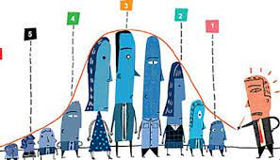



Motivation and Organizational Control
1) Behavioural control
2) Output control
3) Clan or Normative control control

Slide 9

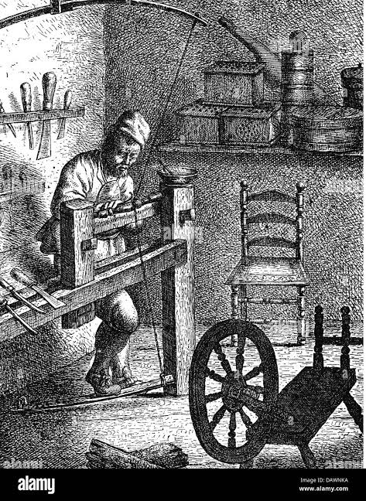
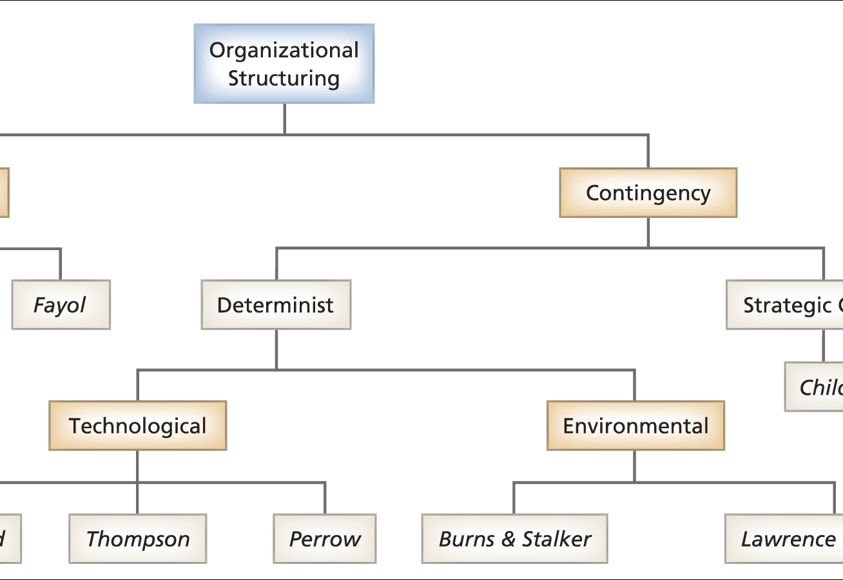
Relation to key concepts
Craft knowledge and the rise of factories (17th to 19th century)
Assumption about workers?
One best way of organizing or something messier?

Slide 10
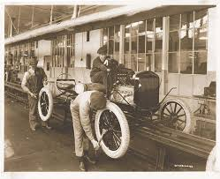
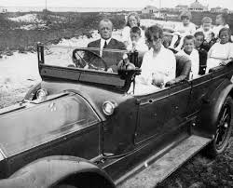
Taylor’s four principles of scientific management (& motivation)
Work broken down (& the Gilbreths)
https://www.youtube.com/watch?v=BJWPuiqznhI
Division of work
3. Scientific selection
4. Co-operation

Slide 11
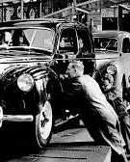
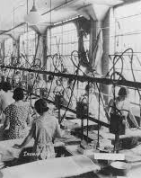

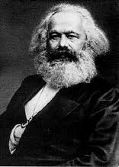
Control and motivation through Taylorism
Standardization
Individualization
Surveillance
Knowledge
Skill
Main problems with this approach?
De-skilling (Braverman, 1974)
Alienation (Marx, 1867)
Iron cage of bureaucracy (Weber, 1904)

Slide 12
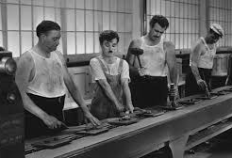
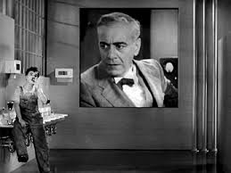
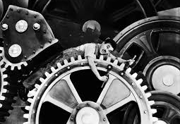
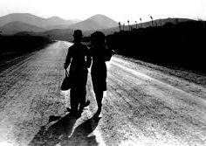
An example from film: Modern Times (1936) https://www.youtube.com/watch?v=DfGs2Y5WJ14 https://www.youtube.com/watch?v=ZdvEGPt4s0Y&t=1s
"Modern Times" is a 1936 film directed by and starring Charlie Chaplin, marking his venture into the age of synchronous sound films. The film opens with a striking juxtaposition of sheep being herded and men entering a factory, setting the stage for its central theme: the dehumanizing effects of industrialization. Chaplin's iconic character, the "tramp," works on an assembly line, where the relentless pace of machinery drives him to madness and highlights the indifference of corporate management. The narrative unfolds during the Great Depression, reflecting the struggles of the unemployed and the working class, making it resonate deeply with contemporary audience” (EBSCO, https://www.ebsco.com/research-starters/history/modern-times-film/)

Slide 13
Theory X & Theory Y
Douglas McGregor, in the 1960s, introduced two contrasting frameworks regarding managerial beliefs about employee behavior (rather than theories of motivation in the traditional sense).
Theory X argues managers assume employees inherently dislike work, are lazy, avoid responsibility, and need to be coerced or controlled to perform effectively. Leads to an authoritarian management style where close supervision and extrinsic motivators like rewards or punishments are emphasized.
Theory Y suggests that employees find work enjoyable, seek responsibility, are creative, and can self-direct when given the chance. Promotes a participative management approach, where trust, autonomy, and opportunities for growth are central. Employees are encouraged to take ownership of their tasks, leading to higher levels of intrinsic motivation.
Key point is that a manager's beliefs about their employees, whether they lean toward Theory X or Theory Y, likely influence their management style (and the ways in which they attempt to motivate).
Reflection: Consider how these underlying beliefs shape the methods managers use to engage and motivate their employees? Do managers' assumptions about their employees' nature limit or enhance the employees' potential?

Slide 14

Content Theories Vs Process Theories
Content Theories
Emphasize the "what" factors that motivate individuals.
Concerned with identifying and categorizing human needs.
Motivation is then driven by fulfilling these specific needs/desires.
Process Theories
Explores “how” motivation occurs.
Believe motivation is a cognitive ‘process’ that involves evaluating different factors before deciding how to act.
Explore the thought processes behind choices, efforts, and persistence.

Slide 15

Exploring Theories of Motivation
Herzberg Two Factor Theory (content)
Needs based theories (content)
Equity Theory (content)
Expectancy Theory (process)
Goal related theories (process)

Slide 16
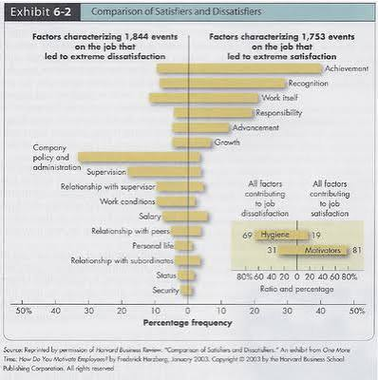
Herzberg’s Two Factor Theory
Herzberg's theory suggests that job satisfaction and dissatisfaction arise from two different sets of factors.
Hygiene Factors: external elements such as salary, working conditions, and job security. Won’t necessarily increase job satisfaction, but absence can lead to dissatisfaction.
Motivating Factors: intrinsic factors such as recognition and responsibility. Drive employees and foster job satisfaction.

Slide 17
Herzberg’s Two Factor Theory
Job satisfaction and dissatisfaction are not on the same continuum, meaning the absence of dissatisfaction does not automatically result in satisfaction.
Influential theory, however, mixed empirical evidence (see Bratton, 2021). Some indication separation between hygiene and motivating factors is not always clear-cut in practice.
Key Point: Improving hygiene factors may reduce dissatisfaction, but to truly enhance motivation and satisfaction, organizations must focus on intrinsic motivators.

Slide 18

An Example: Google https://www.youtube.com/watch?v=n_Cn8eFo7u8
Hygiene factors:
Compensation and Benefits: Highly competitive salaries, top-tier health insurance, and retirement plans.
Working Conditions: Beautiful, ergonomic offices, free gourmet food, on-site gyms, and recreational spaces.
Job Security & Company Policy: Clear human resource policies and stable employment structures.
Motivating factors
The "20% Time" Policy: Google famously allowed engineers to spend 20% of their work time on projects of their own choosing. This autonomy and freedom led to the creation of massive products like Gmail and Google AdSense.
Achievement and Responsibility: Employees are given high levels of ownership and responsibility over massive global projects right from the start of their careers.
Recognition: Peer-to-peer recognition programs, innovation awards, and public acknowledgment give employees a deep sense of accomplishment and status.

Slide 19
Needs based theories
Abraham Maslow’s (1943, 1954) ‘Hierarchy of Needs’

Slide 20




Maslow – Application in the Workplace
Physiological needs: ensuring basic comfort through a suitable working environment and regular salary payments.
Safety needs: sense of security through formal contracts, sickness pay, and adherence to health and safety regulations.
Social/belonging needs: fostering team spirit and promoting social interaction among colleagues to create a cooperative workplace.
Esteem needs: boosting self-esteem by offering performance feedback, recognition, and rewards that reinforce employees’ value.
Self-actualization needs: opportunities for personal and professional growth through career development and challenging tasks that allow individuals to reach their full potential.
Reflection: Maslow stressed that higher-level needs (like self-esteem or self-actualization) will be difficult to fulfill unless lower-level needs (like safety and physiological needs) are met. How does this theory apply to creating motivating work environments?
Critiques based on the Arnold et al (2020) – cultural differences in needs, evidence some people prioritize higher level needs, general lack of empirical support.

Slide 21

Need-based theories
Self-Determination Theory (SDT) was developed by Deci & Ryan (1985) to explain intrinsic motivation. It highlights three core psychological needs:
  Autonomy: Feeling in control of one's actions.
  Competence: The desire to master tasks and achieve success.
  Relatedness: The need to connect with others.
SDT has been applied in various settings, including workplaces, to enhance intrinsic motivation by fulfilling these needs. However, research has suggested that SDT may have lower predictive power in some situations, making its practical application somewhat limited in certain contexts.
Atlassian (Ship it 59): https://www.youtube.com/watch?v=6kRgKu3rUcw
https://www.youtube.com/watch?v=8xiwyk3ouuI

Slide 22

Break time (10 mins)
Next: Process theories of motivation

Slide 23

Equity Theory & Justice Theories
Core Idea: Employees are motivated by perceived fairness of rewards relative to their contribution compared to others.
Types of Justice:
  Distributive Justice: Fairness of outcomes (e.g., equity based on contribution, or equality based on need).
  Procedural Justice: Fair, consistent processes, ethical decisions, and representation.
  Interactional Justice: Respect, dignity, transparency, and honesty in communication.
(See Fortin, 2008 for more details on Justice approaches)
Example: NHS nurses post-pandemic: see https://www.democracytocome.org/covids-hidden-scars-an-academic-art-installation/

Slide 24
Critiquing Justice Theories
Equity judgments are subjective and influenced by individual biases, making ‘fairness’ difficult to measure.
Focuses too much on monetary rewards and underestimates other key motivators (e.g. recognition).
Assumes universal notions of fairness, but cultural norms may shape what individuals consider ‘fair’.
Primarily considers individual comparisons and overlooks the impact of group dynamics on perceived equity.

Slide 25

Expectancy Theory
Proposed by Vroom in 1960s
VIE Framework:
  Expectancy: Confidence in ability to complete the task.
  Instrumentality: Belief that effort will lead to reward.
  Valence: Value placed on the reward.
Statistical Formula: Effort = Expectancy × Instrumentality × Valence
Practical application:
  Ensure employees have the skills to succeed.
  Build trust that effort will lead to rewards.
  Offer meaningful rewards that employees truly value.

Slide 26
Critiquing Expectancy Theory
Assumes individuals are rational decision-makers, ignores emotions and unconscious factors.
Expectancy, instrumentality, and valence are highly subjective and differ greatly among employees.
Not all rewards are tangible, and intrinsic rewards are often overlooked in the theory.
Primarily focuses on individual motivation and neglects social dynamics like teamwork or social influence.

Slide 27



Goal Setting Theory
Key theory developed by Locke and Latham (1990, 2002 ).
A goal is something that a person is attempting to accomplish
SMART Goals: Specific, Measurable, Agreed, Realistic, Time-bound.
Key Moderators of Goal Achievement:
  Commitment: Dedication to achieving the goal.
  Importance: Personal value placed on the goal.
  Self-Efficacy: Belief in one’s ability to succeed.
  Feedback: Regular performance insights.
  Task Complexity: Appropriateness of the goal to the task difficulty.

Slide 28
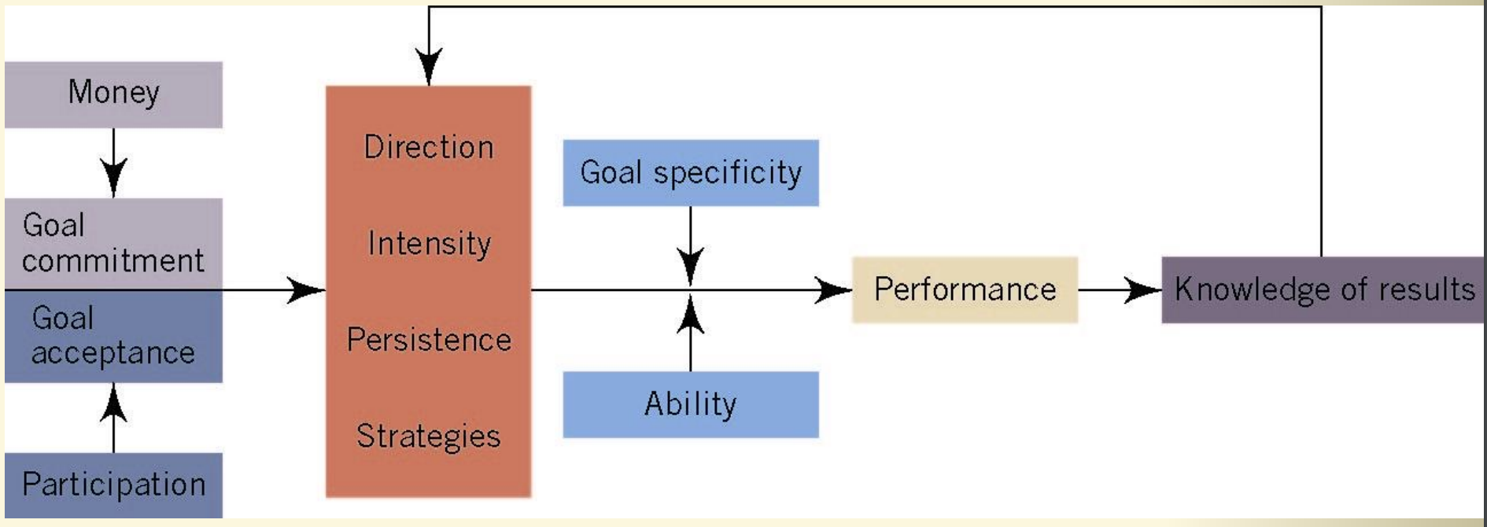
Goals as Motivational Forces

Slide 29

Critiquing Goal based Theories
Multiple Goals: Employees often juggle many goals, some of which may conflict with each other.
Tunnel Vision: Focusing on specific goals can lead to blindness toward other important issues.
Competitive Culture: Can foster excessive competition rather than collaboration.
Rational vs Emotional: Assumes goal pursuit is purely rational, but emotions also influence decisions.
  (Ordonez et al, 2009)

Slide 30
The Future?

Slide 31
Theory Integration
Locke & Latham (Academy of Management Review, 2004):
“When beginning to study the plethora of existing work motivation theories, one’s reaction is sometimes bewilderment at the enormous variety of concepts and approaches. But, if one looks closely, it is evident that, for most part, these theories, though flawed and/or limited in various respects, do not so much contradict one another as focus on different aspects of the motivation process. Therefore, there is now urgent need to tie these theories and processes together into an overall model, insofar as this is possible.”

Slide 32
An Integrated Approach….
Understanding why people think and act the way they do is complex. Can any single theory capture this complexity entirely? Rather than viewing theories as conflicting, maybe they should be seen as complementary?
An alternative more holistic approach would be to integrate elements from both process and content theories, blending explanations of the "why" (motivational drivers) and "how" (mechanisms through which behaviour is directed and sustained).
For more information on integrative models see:
Bratton, J. (2021) Introduction to work and organizational behaviour. (available as e-book)
Klien, H. J. (1989) An integrated control theory model of work motivation, Academy of Management Review, 14 pp. 150-72.
Arnold et al (2020) Work psychology: Understanding human behaviour in the workplace. Pearson: London.

Slide 33
Future Directions:
More employee control = more motivation?
Proactive Motivation
Employees should not only respond to external demands but also be encouraged to take initiative and engage proactively in tasks and challenges. This involves fostering a culture where individuals feel empowered to shape their roles and environment.
Motivation Across the Lifespan
Motivational needs and drivers change over time. It's crucial to understand age-related differences in motivation, as younger employees may be driven by career growth, while older employees might prioritize stability, purpose, or work-life balance.
Contextual Influences
Motivation is not only shaped by personal factors but is also heavily influenced by the surrounding environment, organizational culture, and societal trends. Future research and practice should consider these broader contextual elements when developing motivation strategies.
Beyond Person-Centric Approaches
Traditionally, motivation has focused on individual traits or behaviors. However, future approaches should go beyond person-centric views, considering collective motivation and team dynamics, as well as how organizational systems and policies influence motivation at all levels.

Slide 34
Link between financial rewards, motivation & performance
Common Assumption: Many managers view financial rewards like pay and bonuses as the primary way to motivate and reward good performance.
Theories on Pay: Some motivation theories (e.g. Maslow) emphasize money as a basic need, but Herzberg (1968) argued that while insufficient pay can cause dissatisfaction, financial incentives alone may not drive true motivation.
CIPD Review (Cotton et al, 2022): Strong evidence suggests that financial rewards positively impact both motivation and performance in the workplace.
Individual Differences: The effect of money as a motivator varies based on personal circumstances—what motivates one employee may not be as powerful for another.
Equity Theory Perspective: According to Adam’s Equity Theory, financial rewards must be perceived as fair and equitable to effectively influence motivation. If employees feel under-rewarded compared to others, it can demotivate them.

Slide 35
Reward Packages
Reward Packages:
Financial Rewards: Salaries, bonuses, incentives. Motivation Link: Directly linked to fulfilling basic needs but may not sustain long-term motivation for all employees.
Non-Financial Rewards: Recognition, career development, work-life balance. Motivation link: Often tied to intrinsic motivation, fostering engagement and satisfaction.
Equity and Fairness: According to Equity Theory, employees are motivated when they perceive rewards as fair in comparison to others.
Key points:
Tailored Reward Packages: Different employees are motivated by different types of rewards (financial, recognition, growth).
Balanced Approach: Combining financial and non-financial rewards may be key to sustaining motivation.
Perception Matters: Rewards must be perceived as fair, attainable, and meaningful to truly motivate.

Slide 36

Designing Motivating Jobs
The Job Characteristics Model (JCM), developed by Hackman & Oldham (1976), outlines five key job dimensions that influence motivation and performance.
Core Job Dimensions:
Skill Variety: The extent to which a job requires a range of different skills and abilities.
Task Identity: The degree to which a job requires completing a whole, identifiable piece of work from start to finish.
Task Significance: The perceived importance of the job in terms of its impact on others, both inside and outside the organization.
Autonomy: The level of independence and discretion an employee has in how they perform their tasks.
Feedback: The degree to which an employee receives clear, direct information about their performance.

Slide 37


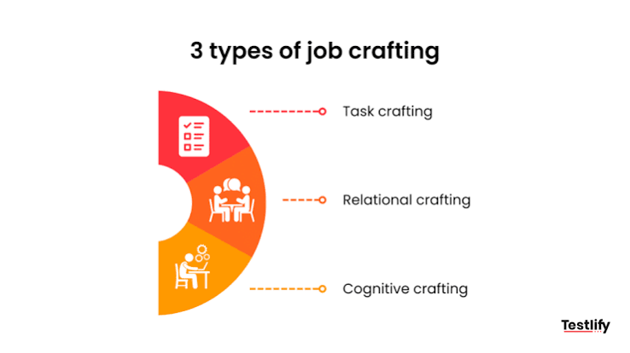
Job Crafting –
Wrzesniewski & Dutton, 2001
The motivation for job crafting arises from three individual needs:
1. Need for control over job and work meaning
2. Need for positive self-image
3. Need for human connection with others

Slide 38

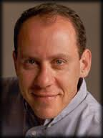
Radical approaches to motivation
Example of a democratic organization: SEMCO
Ricardo Semler, CEO of Semco, recognises the infantalization of the workforce:
“outside the factory, workers are men and women who elect governments, serve in the army, lead community projects, raise and educate families, and make decisions every day about the future. Friends solicit their advice. Salespeople court them. Children and grandchildren look up to them for their wisdom and experience. But the moment they walk into the factory, the company transforms them into adolescents. They have to wear badges and name tags, arrive at a certain time, stand in line to punch the clock or eat their lunch, get permission to go to the bathroom, give lengthy explanations every time they're five minutes late, and follow instructions without asking a lot of questions.”
Semler, “managing without managers” 2010.
Leads Semler to eliminate time clocks, dress codes, security checks and introduce voting on key issues (including setting wages)
Semler on the democratic workplace: (0-5 mins and 13.25 to 16.50 mins)
https://www.youtube.com/watch?v=UxeosFrLFH8

Slide 39
Lecture Summary
Organizations strive to cultivate a motivated workforce to drive performance and achieve business goals. However, applying motivation theories in practice presents challenges, as managers often need to adapt to suit the unique needs of their workplace and employees.
Each employee has unique needs, preferences, and motivators. A one-size-fits-all approach may not work, as people vary in what they want, need, and value.
Managers must consider factors such as age, gender, race, ethnicity, and disabilities, which shape both life experiences and work dynamics. These elements can significantly affect how individuals respond to motivational strategies.
Creating effective reward packages and job designs that align with motivational needs is essential. Financial and non-financial rewards, as well as the structure and nature of tasks, play a key role in motivation and performance.

Slide 40
Tutorials 4 & 5 – Applying Theories of Motivation
Key Reading for the Tutorial: Please read Chapter 6 (Work Motivation) in Work Psychology: Understanding Human Behaviour by Arnold et al. (2020).
Case study: An Unmotivated Worker (available on blackboard).
Using the motivation theories discussed in your lecture on this topic and in the book chapter required for your key reading, you will work in small groups to develop answers to the following questions:
How would these theories describe and explain the problems with Simon Lucas's motivation? (focus on two or three theories, perhaps one content and one process theory).
To what extent do these theories provide guidance to Katherine Walker about what she should do? What actions would they recommend?
Each small group will prepare a 5-minute presentation of their answers. You will then present your findings to the rest of the class in Tutorial 5.
Please note, you will need to meet (either online or in-person) away from the class to prepare your presentations, so please ensure you swap contact details and allocate tasks where appropriate.

Slide 41
3 Key Readings
Please read the following chapter and journal article.
1. Chapter 6 (Motivation at Work) in Arnold, J. et al. (2020) Work psychology: understanding human behaviour in the workplace. 7th edition. Harlow, England: Pearson.
2. Kanfer, R., Frese, M. and Johnson, R.E., 2017. Motivation related to work: A century of progress. Journal of Applied Psychology, 102(3), p.338.
The chapter below is also very useful for this topic (I have put it in the reading list) and may help you with your presentations.
3. Chapter 7 (Motivation) in Bratton, J. (2021) Work and organizational behaviour. Fourth edition. London: Red Globe Press.

